Slide 1
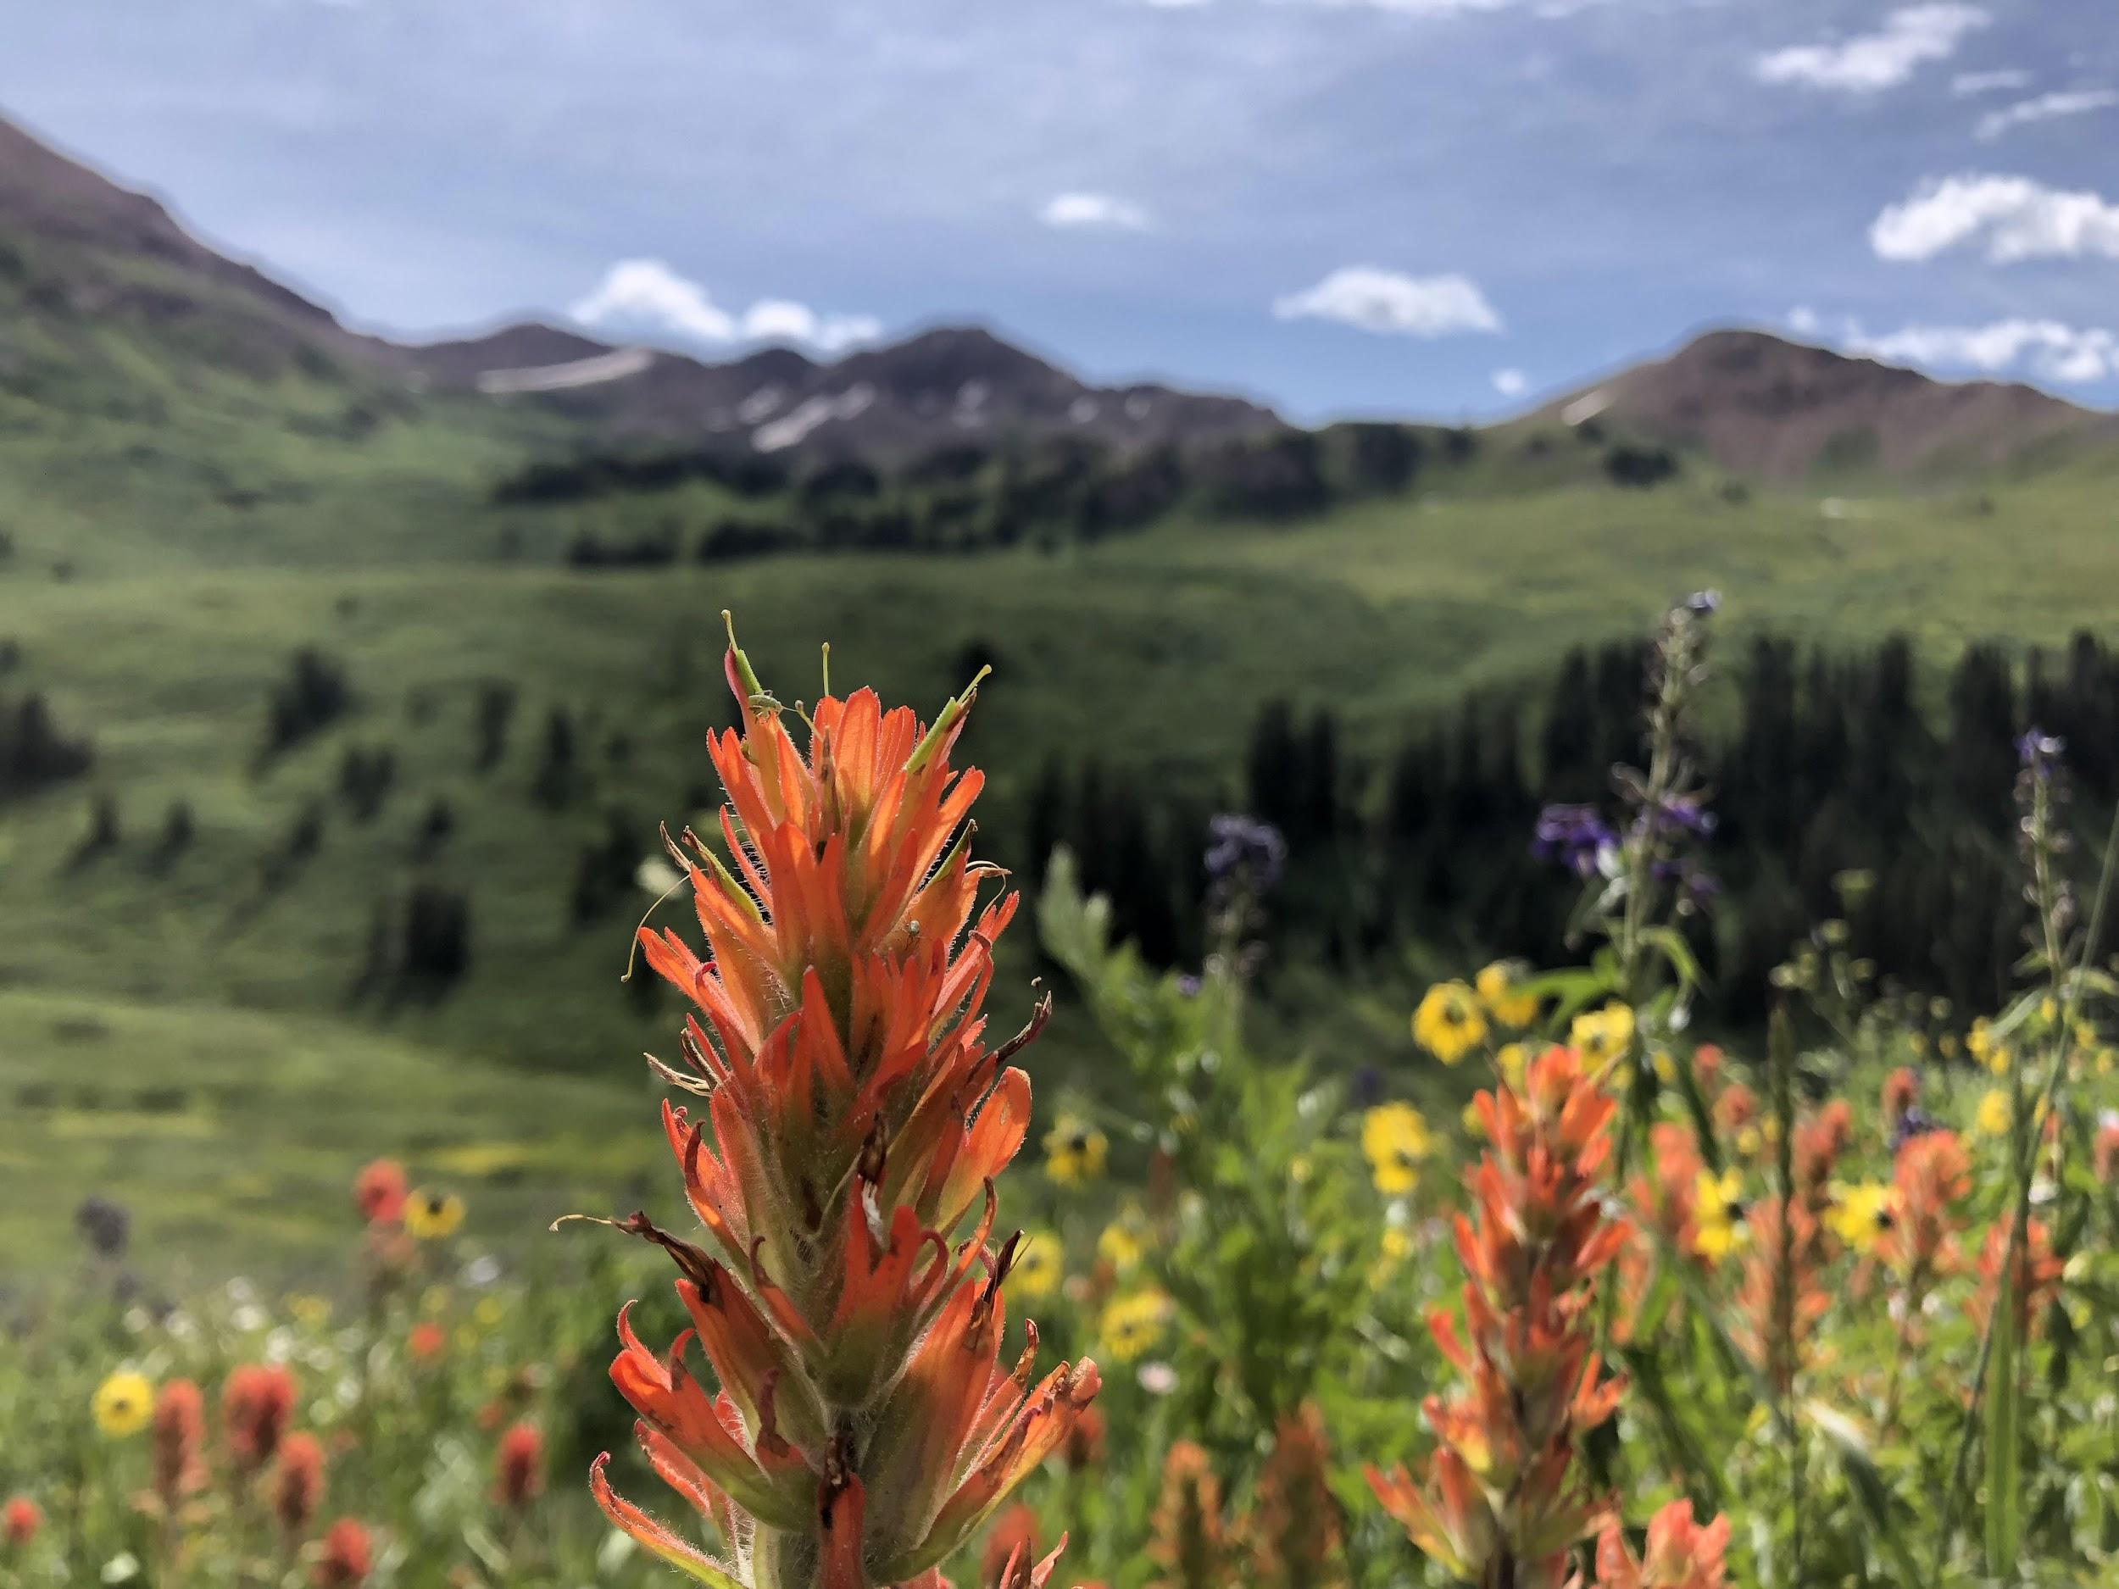

Creating a COVID-19 recovery map and scenario planning

Slide 2
What we will be covering:
Laying the groundwork for long-term recovery conversations
Developing a vision for recovery in your community
Defining strategies and actions to meet your vision
Scenario planning

Slide 3

Laying the groundwork
Image credit: Anna Zoromski

Slide 4
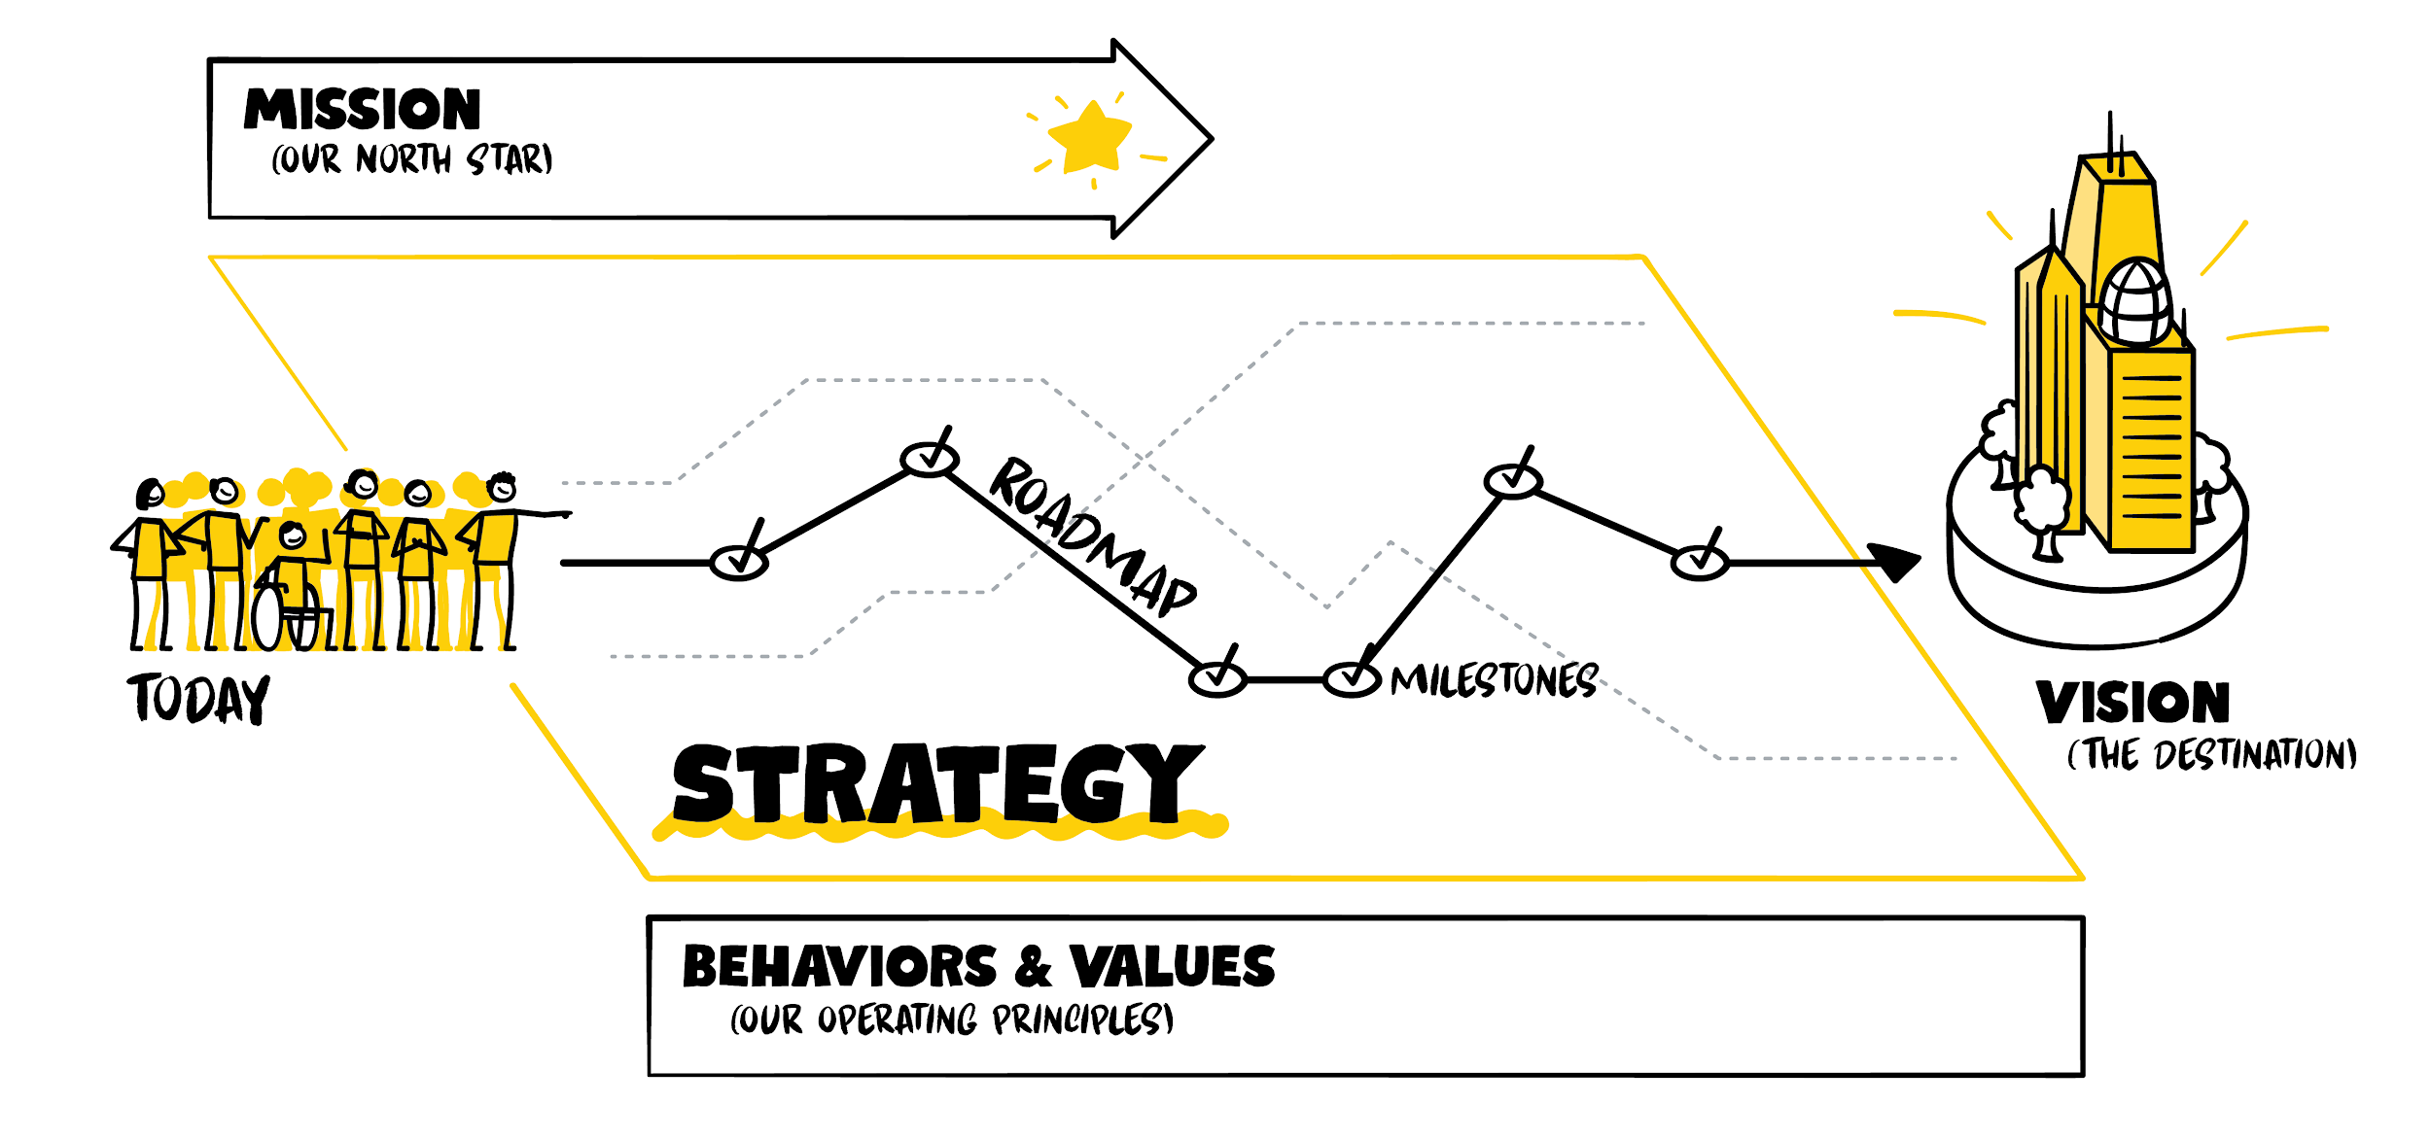
In recovery, we need to know where we are going
Image credit: XPLANE

Slide 5
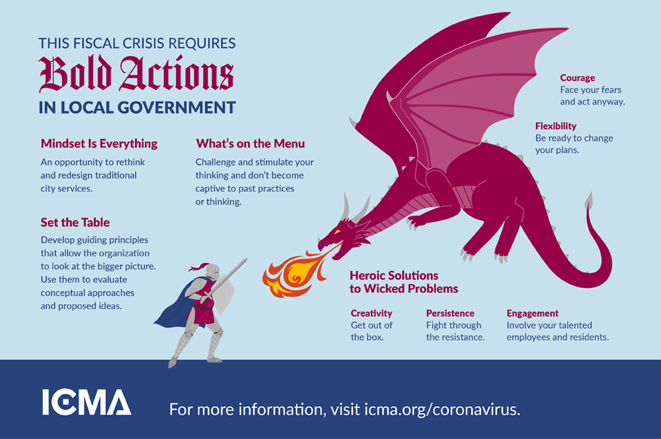
And we have the opportunity to be bold and creative

Slide 6

A note on brainstorming
Want to have better brainstorming sessions? These could be particularly useful when developing vision, strategies, and actions.
Our Rural Prosperity Manager loves this exercise
Check out XPLANE’s tips for remote collaboration

Slide 7
Where to start: Values and vision
"Rowing harder doesn't help if the boat is headed in the wrong direction." - Kenichi Ohmae
Define values-What’s our purpose? What do we do well?
Define vision-Where do we want to go in COVID-19 recovery-exactly?
  What will our community look like when the pandemic is over?
  Don’t be bound by convention and think your vision needs to be one sentence. Maybe it’s a set of phrases. Maybe it’s a few sentences.
  Get specific in your vision. It needs to be descriptive enough that it’s something that can be attained.
*Pro tip-don’t bog yourself down too much in developing perfect vision statements and strategies. Be intentional, simple, and swift.
Notes:
Your organization should start by defining its values and vision in recovery, in order to define where you want to end up and identify potential opportunities along the way.
Define values-What’s our purpose? What do we do well?
How does what we do well adapt or fill gaps during recovery?
Your values should drive how you do businesses
Define vision-Where do we want to go in COVID-19 recovery-exactly?
What will our community look like when the pandemic is over?
Consider different aspects of your community such as businesses, residents quality of life, infrastructure, natural resources etc.
Don’t be bound by convention and think your vision needs to be one sentence. Maybe it’s a set of phrases. Maybe it’s a few sentences.
Get specific in your vision. It needs to be descriptive enough that it’s something that can be attained.
Instead of “thriving businesses” as an end vision for recovery, think of things that will ensure they thrive.
Example-Small businesses are fiscally stable, adapting to change, and partner with each other and local government, in order to thrive.

Slide 8
Other initial questions to ask
What has or has not been working in local government approach? What should you keep doing? What should you stop doing?
  What services/practices were suspended during COVID-19 response? Are these reimplemented going forward?
  What changes to services, fees, programs, staff organization were made in response to COVID-19 that should remain going forward?
Create a plan to communicate and engage with stakeholders
  Identify potentially affected interests as your starting point
  Are stakeholders getting the information they need from local government? What’s working? What’s falling through the cracks?
  Is your organization getting the information it needs? From the community, stakeholders, business community, other local governments, the State? If not, what mechanisms or relationships do you need to put in place to do so?
  What new or existing partnerships have been created or improved? Is there a role for these partnerships going forward, beyond COVID-19, that will help with better and more effective government?
Notes:
ed? Is there a role for these partnerships going forward, beyond COVID-19, that will help with better and more effective government?
Recommendation: form a resilience and recovery team
Who should lead: county/local government
Stakeholders should include:
Elected officials, municipal and county staff, emergency management, public health, economic development organizations, school districts, higher education, members of the community who represent diverse industries/businesses, local chamber of commerce, any non-profits who support work locally and regionally, private sector technical experts - natural resources, lenders, tourism, etc.

Slide 9
Pause to define opportunities
Some examples of opportunities:
Government becomes more nimble and connected
  Maintain cultures of rapid experimentation and innovation
  Consider what red tape was removed during response that should not be put back in place
  Communities in corridors with intertwined economies create the mechanism for continued collaboration
  Local government and business community partner to help drive economic recovery
Capitalizing on community assets and strengths
  Identify community strengths and assets that might aid in recovery
  Identify areas entrepreneurs, small businesses, and creatives may provide recovery resources/skills
Economic diversification
  Market to location independent workforce, build on remote work momentum
  Identify potential market trends to think about future industry attraction opportunities
Notes:
The unknown and uncertain nature of COVID-19 gives us the opportunity to try things, reimagine aspects of our community, and even accelerate our community forward in some ways.

Slide 10
Define emerging and ongoing impacts and disruptions
Spend time as a team identifying emerging and ongoing needs and then prioritize the needs to develop strategies and actions.
Examples of emerging needs
  Healthcare resources-PPE, testing, contact tracing, personnel
  Businesses support-access to capital, technical assistance navigating resources, guidance on safety protocols
  Mental health resources
Examples of ongoing stresses highlighted by COVID-19
  Access to healthcare in rural Colorado
  Lack of economic diversification
  Childcare
  Lack of and unreliable broadband
  Leadership instability, turnover, conflict
  Fiscal stability of the organization
  Natural hazards-fires and floods
  Staff capacity
  Economic transitions-loss of major employers, shifts in industries
Notes:
COVID-19 is the stress we are responding to, but we need to define its impacts more specifically. Some of these were impacts before that have just been exacerbated now.
*We think good old fashioned dot voting is a great way to prioritize.*

Slide 11
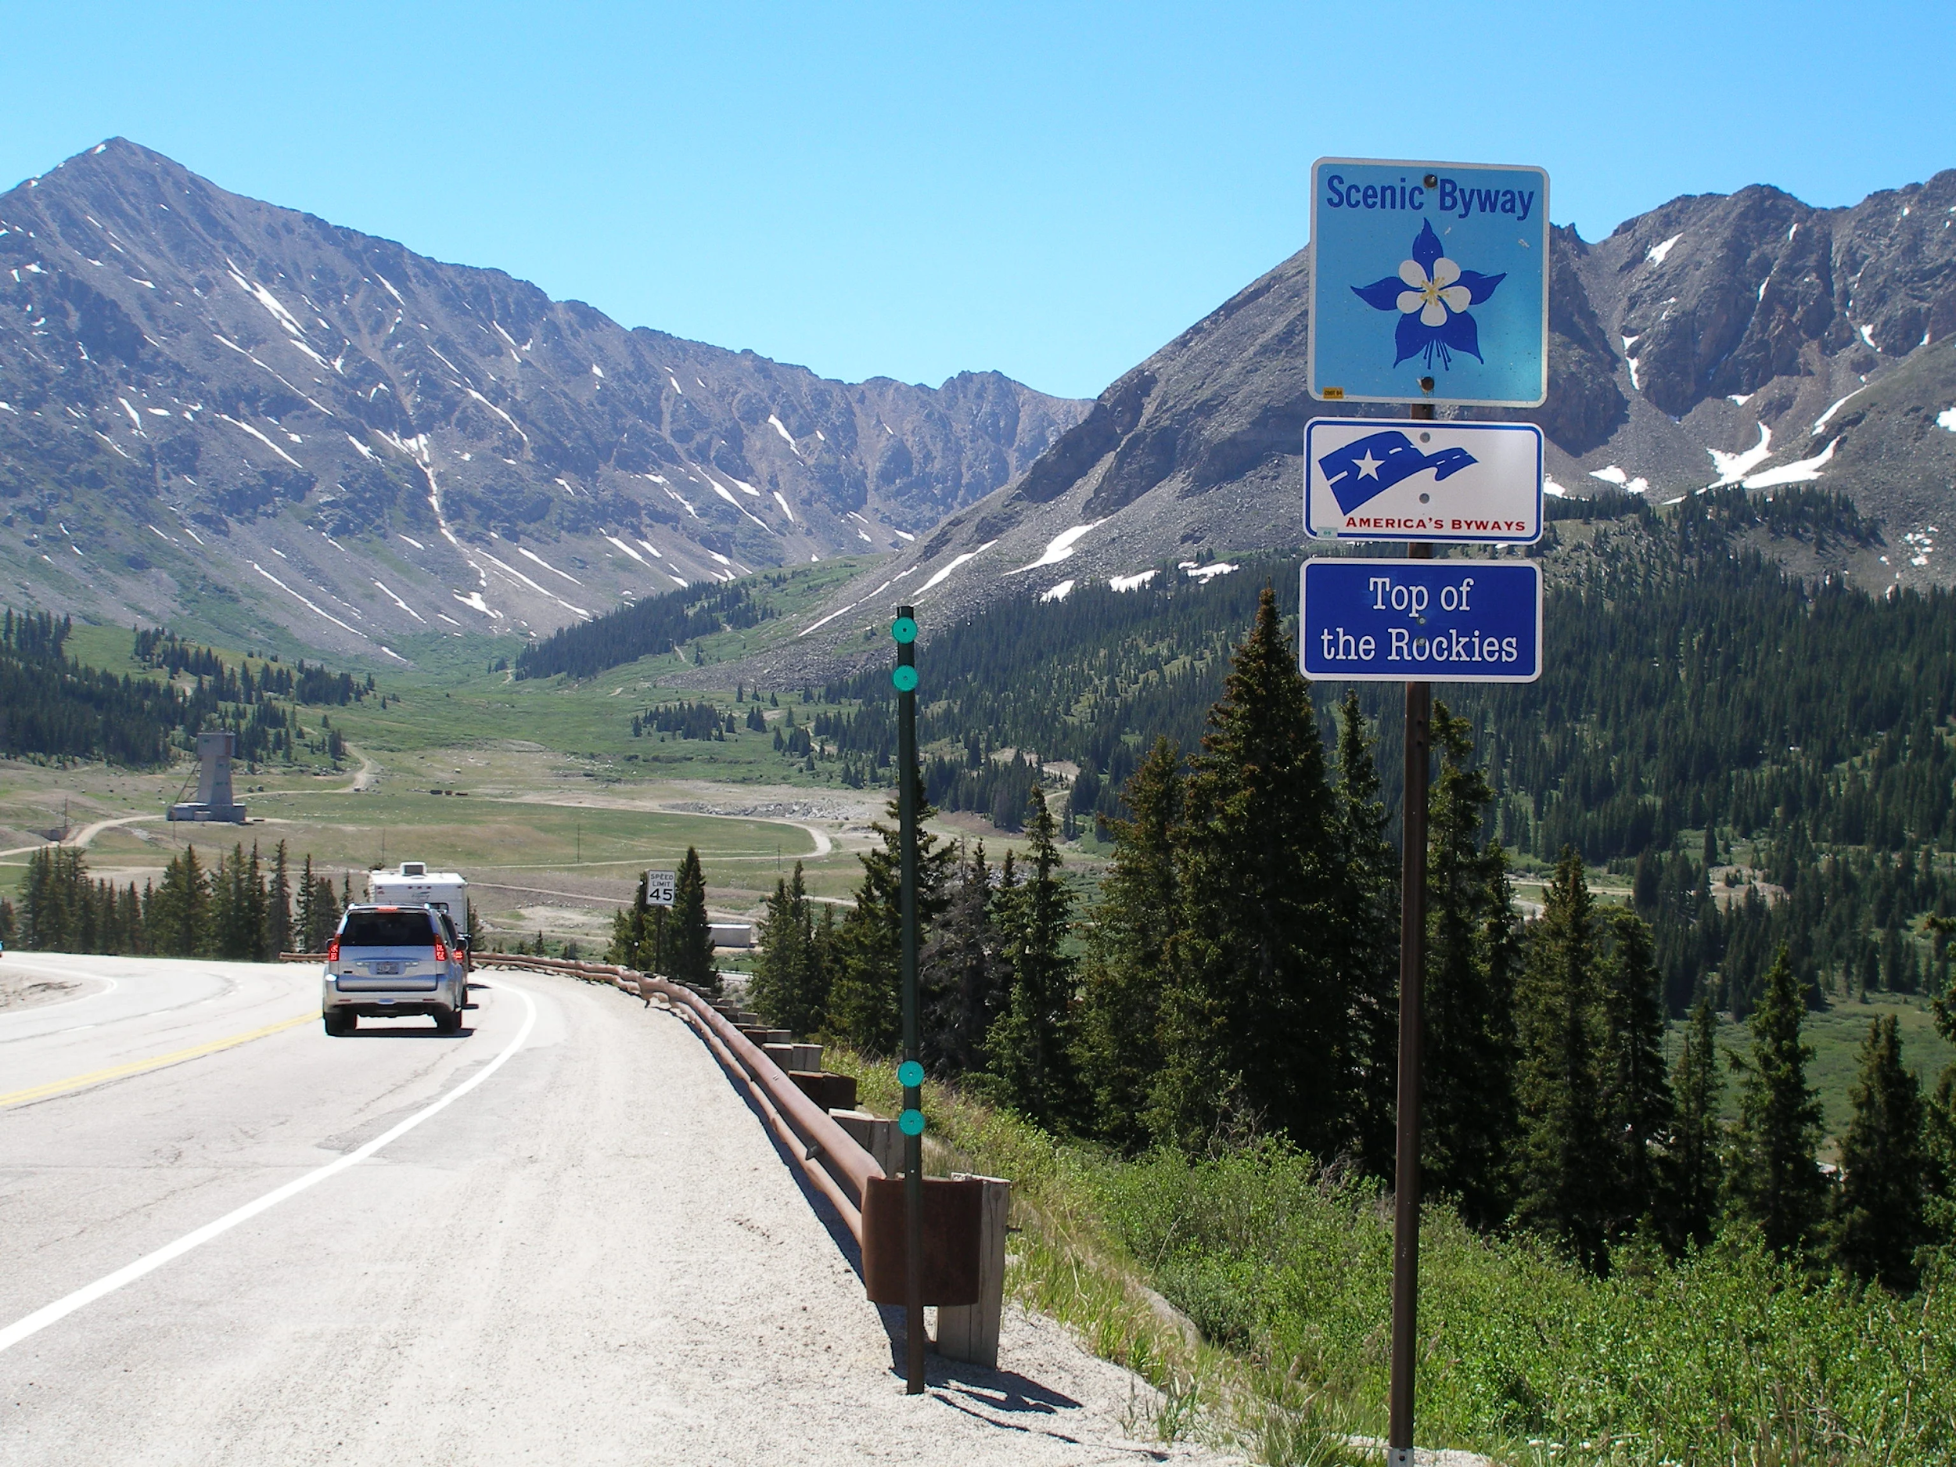
Creating a recovery roadmap

Slide 12
Elements of your recovery roadmap
Values and vision-these should be defined in the laying the groundwork step
Define strategies-these are our route to the destination (destination=vision)
  A good strategy includes what and why
  Need some inspiration? Community Builders has an excellent set of ideas for community and economic development strategies. Progressive Urban Management Associates has also developed some good strategies.
Action planning-steps to get to strategies
  Role mapping-who is in charge of moving strategies and action forward
    Build teams around strategies. Teams should come from across departments and build on skills and expertise
Notes:
**Both values and vision need to become practice. Not just statements. Everything should align with them and work towards them**
Action planning-steps to get to strategies
Role mapping-who is in charge of moving strategies and action forward
Build teams around strategies. Teams should come from across departments and build on skills and expertise
Rapid evaluation
Strategies should be the route to the destination, but not locked in to ways to get there, maintain flexibility in path
Develop milestones to measure progress towards the destination
Build process for monthly evaluation of progress and whether conditions have changed and need to rethink actions

Slide 13
Scenario planning-planning for winter and surges

Slide 14
A moment for reflection
What have we learned since the first shutdown?
  Needed resources
  Ways to organize
  Communication structure
    Did you have one source of trusted information?
    Did information flow from this entity to other stakeholders on a predictable schedule?
  People missing from the conversation
  What role did public health play on your teams? What role do they need to play going forward - if another surge?
  What creativity or innovation happened in round one that should continue forward?
What role does local government play in COVID-19 recovery? This should build on your vision and values.

Slide 15
Scenario planning
Consider three scenarios (credit Rebecca Ryan)
  Challenging
  Expected
  Visionary-what can we be
Run these scenarios over different time horizons-6 months, post-vaccine

Slide 16
Some questions to ask under different scenarios
How are you working in collaboration to stay safe and open?
How does business, local government, and public health work together? They should start now.
What systems do we need for businesses and industries to keep them open and safe? How can the local government educate and help local businesses with their own resilience planning?
What happens in the fall and winter, when our outdoor business adaptations can no longer continue?
What are the health care protocols and messaging we need to reinforce now to avoid a larger resurgence?
How do we maintain momentum and behavior change, when people are tired and stressed?
  Take care of yourselves!

Slide 17

Local Highlights: Gunnison County Economic Recovery Dashboard and Coronameter
•Gunnison County uses 5 tiered coronameter system, which links various health indicators to different levels of community openness
•Worked with Community Builder to create an economic recovery dashboard, which tracks monthly business status, employment status, revenue and taxes, spending habits, food security and housing

Slide 18
DOLA Resources
Energy/Mineral Impact Assistance Fund
CDBG-CV Funding for Public Facilities
CARES Act Funding
COVID-19 Community Adaptation Hub
Small Communities Workshop
COVID-19 Recovery Peer Exchange
Main Street program

Slide 19
Updates for Western Colorado
OEDIT Programs Update:
Pending programs
  EDA Grant applications by OEDIT & DOLA
  RTAP Program
  Remote Learner
SBDC
Opportunity Zone Capital Accelerator Program
  Applications are open from July 20 to August 31 for the second cohort of businesses for an Opportunity Zone program that provides free consulting services to businesses to help them secure OZ business equity investments.
  OEDIT is working with the Colorado Center for Innovation in Community Capital (CC4ICC) to encourage investments in opportunity zone businesses throughout the state. Meet our first cohort of six businesses.
  As a part of the program, CC4ICC will be guiding 10 opportunity zone businesses through the process of: Developing a pitch deck, Business planning, Connecting with investors, Securing investment.

Slide 20
Updates for Western Colorado
OEDIT Programs Update:
Employee Ownership Pilot Program
  The pilot program will fund approximately 10 business loans, up to $10,000 per loan. Loan funding is available for no greater than fifty percent of the cost of technical assistance costs, not to exceed $10,000. Loans must be held by the owner of the existing business. Favorable loan rates and terms offered by participating lenders.
  Contact: John Kovacs
john.kovacs@state.co.us / 303-892-3840
LONE Community Marketing Grants
  Rural communities may apply for up to $5,000 in Location Neutral Employment Program marketing funds to help attract companies to locate remote rural workers in their community.
  Webinar on Location Neutral Job Growth Incentive & Community Marketing Grants

Slide 21
Updates for Western Colorado
OEDIT Programs Update:
Rural Jump Start
  The Rural Jump-Start Zone program (based on Senate Bill 15-282) is a tax relief program for new businesses and new hires who locate into certain designated areas called Jump-Start zones. The program offers the following benefits:
    Relief from state income taxes for the new business
    Relief from the state sales & use tax for the business
    Relief from county and municipal personal property taxes for the business
    Relief from state income taxes for the employee
  Contact: Andrea Blankenship
Andrea.Blankenship@state.co.us / 303.319.8112
Advanced Industries Programs
  Export Accelerator Program: for aspiring and current Colorado exporters. The grant program supports eligible small and medium-sized business through funds to offset international business development and marketing costs.

Slide 22
Updates for Western Colorado
OEDIT Programs Update:
Responsible Recreation Initiatives
  Colorado Tourism Office: Care for Colorado Responsible Tourism Toolkit (in partnership with Leave No Trace)
  Colorado Tourism Office: Colorado Concierge Program
  Outdoor Recreation Industry Office - Recreate Responsibly campaign, Coalition & Toolkit (in partnership with REI & O-Rec industry leaders)
  other Tourism programs - marketing matching grant cycle now open
  other Outdoor Rec programs - continued development of regional coalitions
Minority Business Office
  Helps minority-, woman- and veteran-owned businesses navigate the complex world of certifications and government contracting at the federal, state, local and private level.

Slide 23


Updates for Western Colorado
Partner Programs Update:
StartUp Colorado: https://startupcolorado.org/
  Scholarships to entrepreneurs for educational, networking, or community building events & community sponsorships for entrepreneurial development support
  Regional Calls & Crisis Solutions for Entrepreneurs by Entrepreneurs Podcasts: 8/19 theme - financial resources & federal funding updates
Host: Telluride Foundation & Northwest SBDC Host: Ogallala Commons & Northeast SBDC
Zoom Video & Audio Link Zoom Video & Audio Link
Dial-in Instructions: Dial-in Instructions:
Phone Number: 346-248-7799 Phone Number: 346-248-7799
Webinar ID: 967-9122-4178 Participant ID: 923-2729-5078

Slide 24
Updates for Western Colorado
Partner Programs Update:
Colorado Lawyers’ Committee - Colorado COVID Legal Relief: https://www.coloradocovidrelief.org/
  Match small businesses that need limited legal advice regarding COVID-19 related issues with volunteer lawyers
  August 20: EVICTION CLINIC OFFERING TENANT/LANDLORD GUIDANCE, registration currently closed, but webinar will be available
CU - CAM Creative Corps (partnership with Colorado Creative Industries & Colorado Office of Film Television & Media):
  CU-Denver CAM Students can help non-profit arts and cultural organizations pivot to online programming and remote learning opportunities.
  Students can also provide guidance on subjects such as reaching audiences through Instagram, utilizing multiple live streams, whether to present live or pre-recorded presentations and best practices for participating in a video presentation. How-to documents can also be provided for most platforms.

Slide 25
Updates for Western Colorado
Partner Programs Update:
Energize Colorado: https://energizecolorado.com/
  PPE & Supplies Marketplace for businesses & nonprofits
  Small Business Mentorship & Professional Services
  Re-opening / Continuing Operations Guidance during COVID resources
  Funding Resources
  Mental Health Resources
  Webinars
Manufacturer’s Edge: https://www.manufacturersedge.com/
  PPE supplier list
  Supply Chain Connections
  Ongoing training for adaptations
Economic Development Council of Colorado
  CO Food Systems Advisory Council / EDCC Food Systems Workshops
  CSU Food Systems CO Blueprint
  National Western Center Food System: Vision, Stakeholder roles across the food system, Systems Map with detail about how the system might work in the future

Slide 26
Updates for Western Colorado
Funding Updates:
Alternative Funding Worksheet
Energize Colorado Gap Fund: https://energizecolorado.com/gap-fund/
  More than $25M in small business loans and grants to boost small business enterprises that are the economic engines throughout the state. Sole proprietors, businesses and nonprofits with less than 25 full-time employees can apply for up to a $15,000 grant and a $20,000 loan for a possible combined total of $35,000 in financial assistance. The application is not currently available, it will launch this month and will be accessible through the web page.
  Applications and awards will be done in rounds to allow us to provide assistance through December 2020. The process will not be first-come-first-serve, it will be a competitive process that will help those in need receive priority access to assistance.
  Priority Will Be Given to the Following: Who are majority-owned by Black, Indigenous, People of Color, Veterans, or Women; In rural areas with a population of less than 50,000 people; In the tourism sector; With limited or no access to capital financing or other federal, state or local grants/loans.

Slide 27

How to reach us:
Katharina Papenbrock
  P 720-830-5707
  katharina.papenbrock@state.co.us

